Slide 1


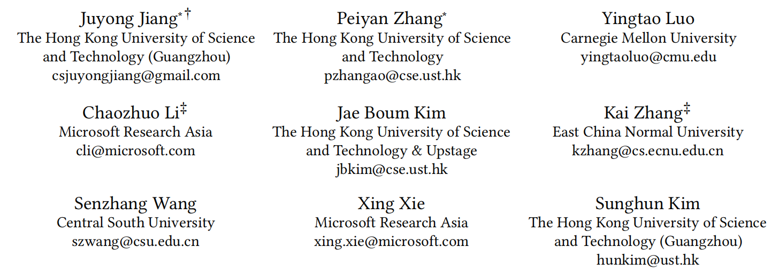


ATAI
Advanced Technique of Artificial Intelligence
Chongqing University ^{ATAI}
_{of Technology} Advanced Technique of
Artificial Intelligence
Chongqing University of Technology
AdaMCT: Adaptive Mixture of CNN-Transformer for Sequential
Recommendation
code: https://github.com/juyongjiang/AdaMCT.
CIKM 2023
Reported by Minqin Li

Slide 2

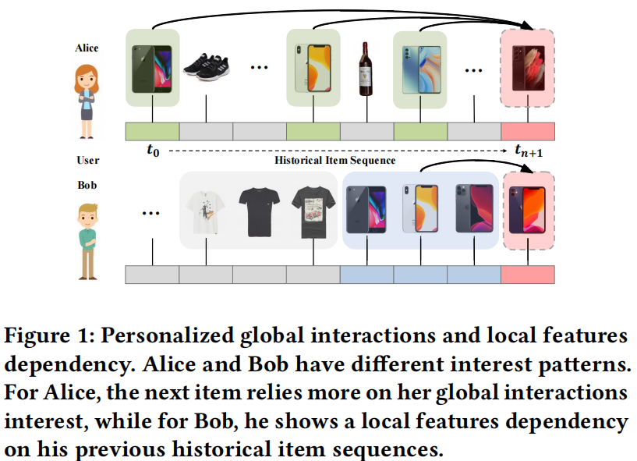
ATAI
Advanced Technique of Artificial Intelligence
Chongqing University ^{ATAI}
_{of Technology} Advanced Technique of
Artificial Intelligence
Chongqing University of Technology
Introduction
(1) How can long-term and short-term preferences be modeled conjointly?
(2) How to integrate the short-term and long-term preferences effectively?
(3) How can multiple relevant items be considered concurrently
in long-term and short-term preference modeling?

Slide 3

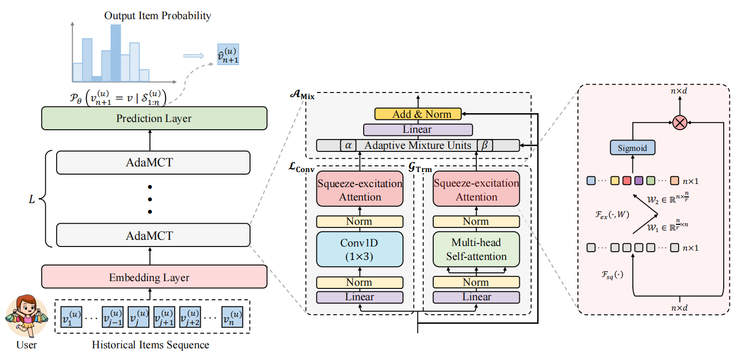
ATAI
Advanced Technique of Artificial Intelligence
Chongqing University ^{ATAI}
_{of Technology} Advanced Technique of
Artificial Intelligence
Chongqing University of Technology
Method

Slide 4
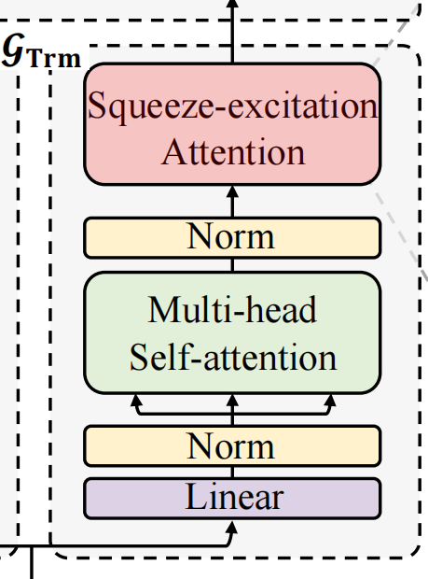
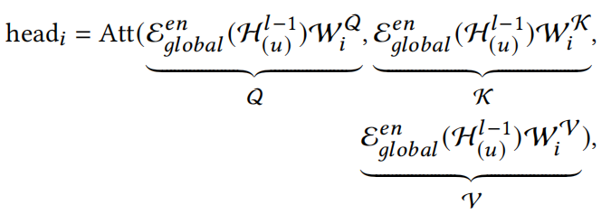

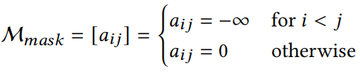
ATAI
Advanced Technique of Artificial Intelligence
Chongqing University ^{ATAI}
_{of Technology} Advanced Technique of
Artificial Intelligence
Chongqing University of Technology
Method
(1)
(2)
(3)
(4)
(5)
(6)

Slide 5
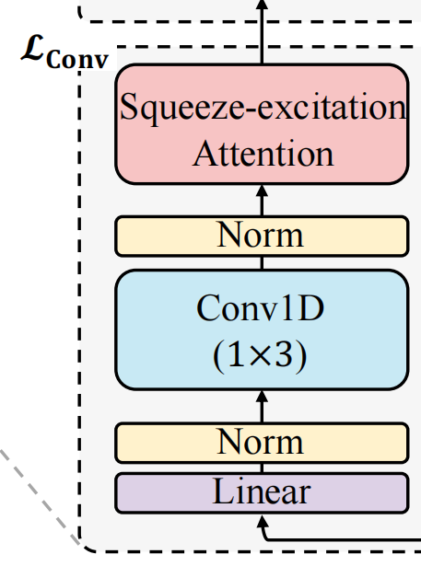


ATAI
Advanced Technique of Artificial Intelligence
Chongqing University ^{ATAI}
_{of Technology} Advanced Technique of
Artificial Intelligence
Chongqing University of Technology
Method
(7)
(8)
(9)
(10)
(11)

Slide 6
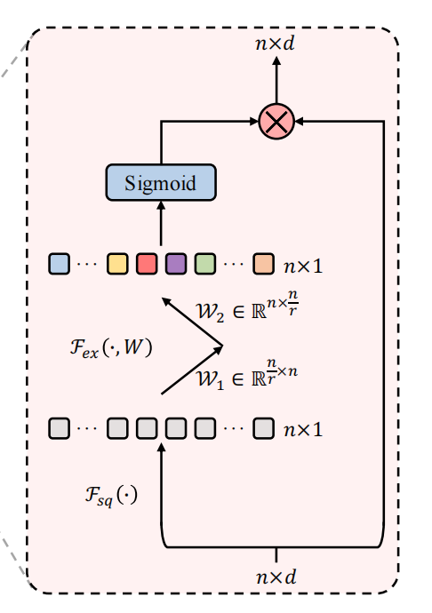


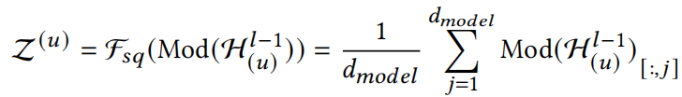
ATAI
Advanced Technique of Artificial Intelligence
Chongqing University ^{ATAI}
_{of Technology} Advanced Technique of
Artificial Intelligence
Chongqing University of Technology
Method
(12)
(13)
(14)

Slide 7
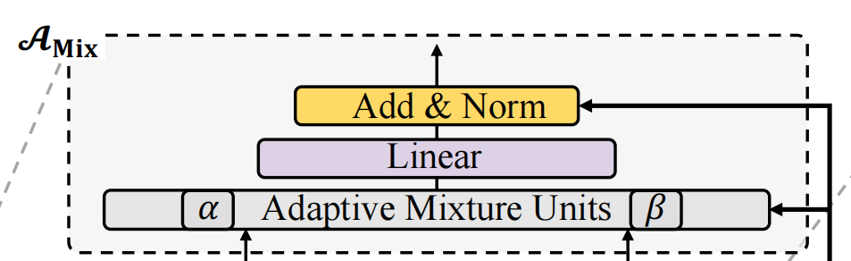



ATAI
Advanced Technique of Artificial Intelligence
Chongqing University ^{ATAI}
_{of Technology} Advanced Technique of
Artificial Intelligence
Chongqing University of Technology
Method
(15)
(16)
(17)
(18)
(19)
(20)

Slide 8

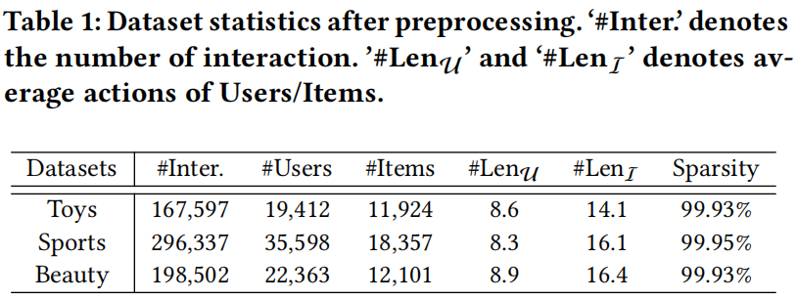
Chongqing University ^{ATAI}
_{of Technology} Advanced Technique of
Artificial Intelligence
Chongqing University of Technology
Experiments

Slide 9
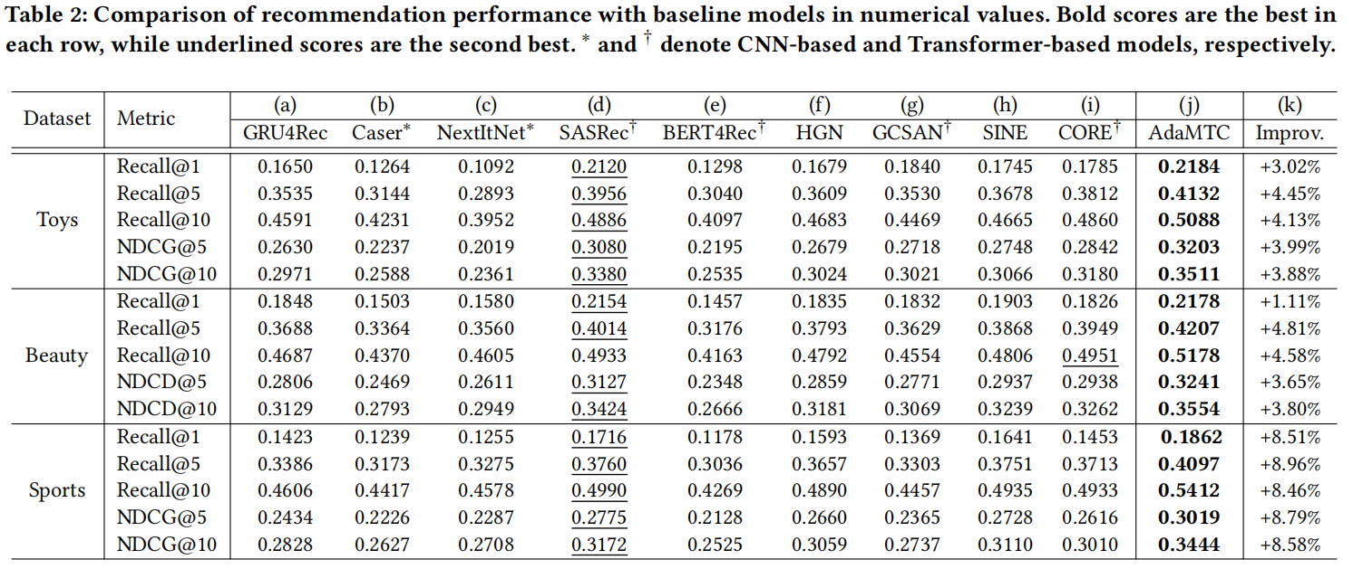
Chongqing University ^{ATAI}
_{of Technology} Advanced Technique of
Artificial Intelligence
Chongqing University of Technology
Experiments

Slide 10
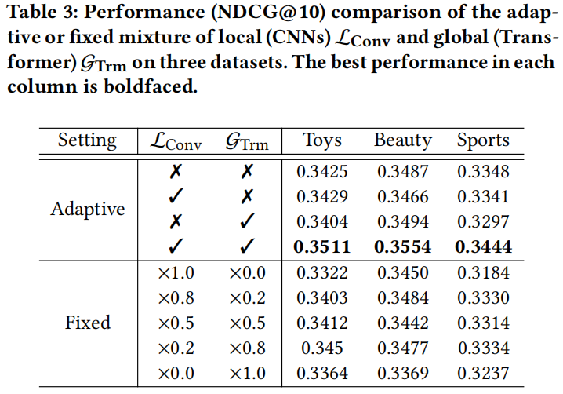
Chongqing University ^{ATAI}
_{of Technology} Advanced Technique of
Artificial Intelligence
Chongqing University of Technology
Experiments

Slide 11
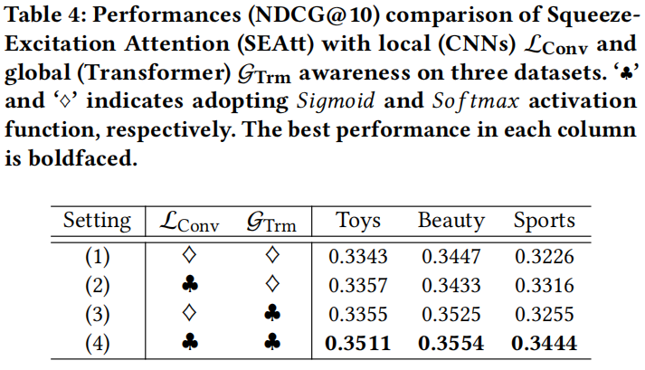
Chongqing University ^{ATAI}
_{of Technology} Advanced Technique of
Artificial Intelligence
Chongqing University of Technology
Experiments

Slide 12
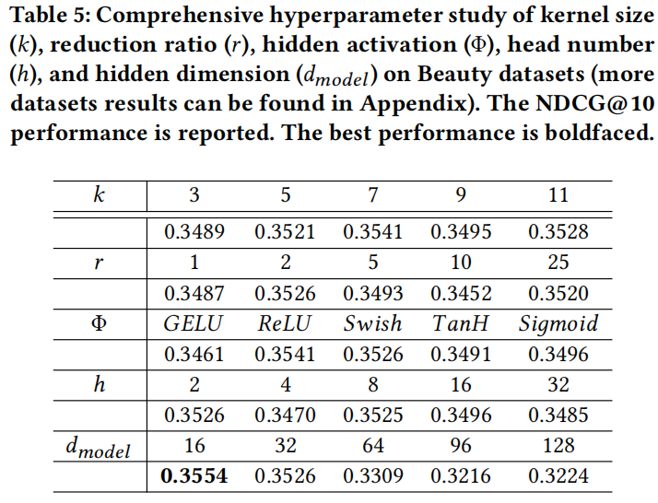
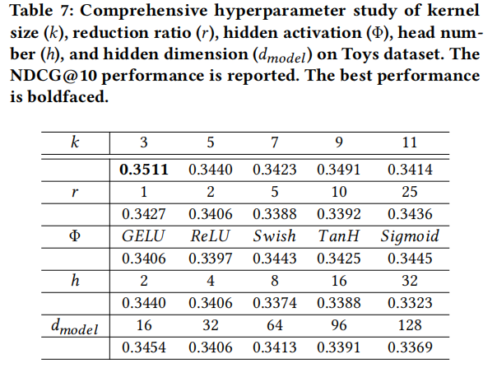
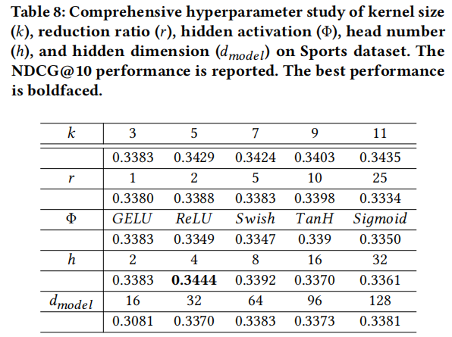
Chongqing University ^{ATAI}
_{of Technology} Advanced Technique of
Artificial Intelligence
Chongqing University of Technology
Experiments

Slide 13
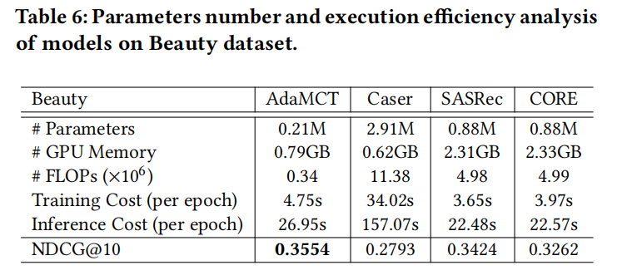
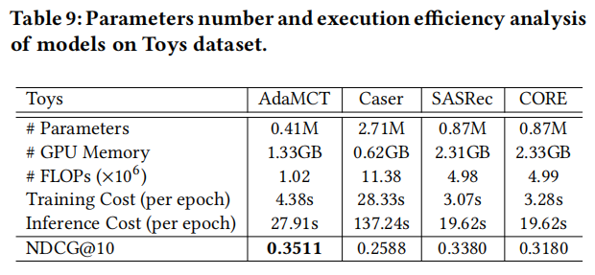
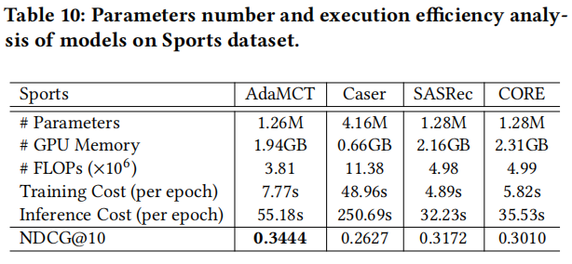
Chongqing University ^{ATAI}
_{of Technology} Advanced Technique of
Artificial Intelligence
Chongqing University of Technology
Experiments

Slide 14
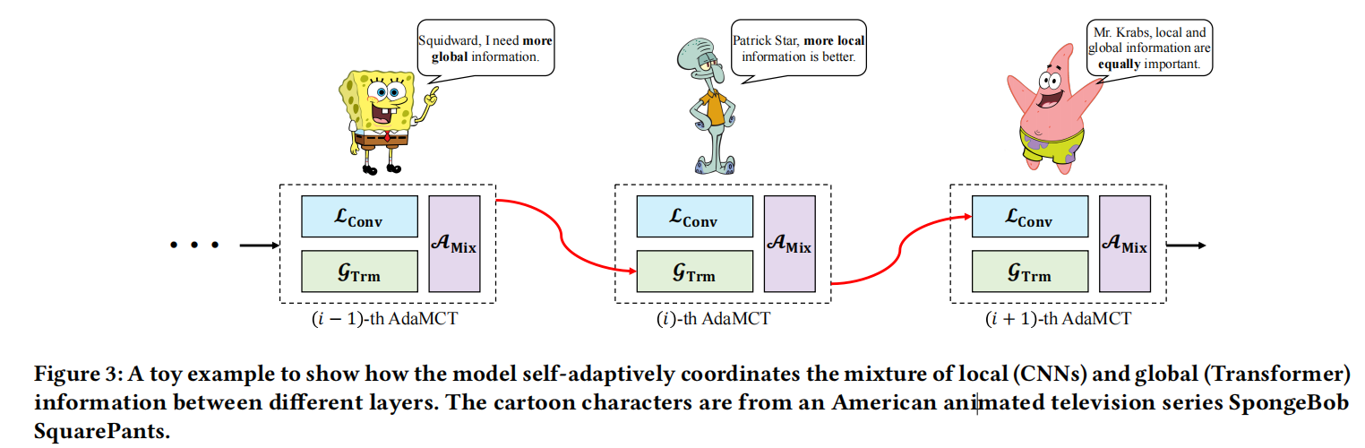
Chongqing University ^{ATAI}
_{of Technology} Advanced Technique of
Artificial Intelligence
Chongqing University of Technology

Slide 15
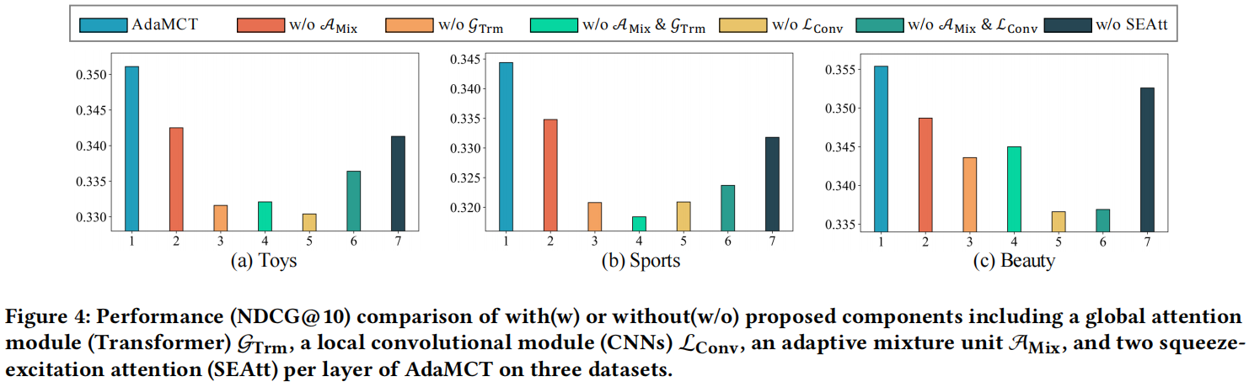
Chongqing University ^{ATAI}
_{of Technology} Advanced Technique of
Artificial Intelligence
Chongqing University of Technology
Experiments

Slide 16
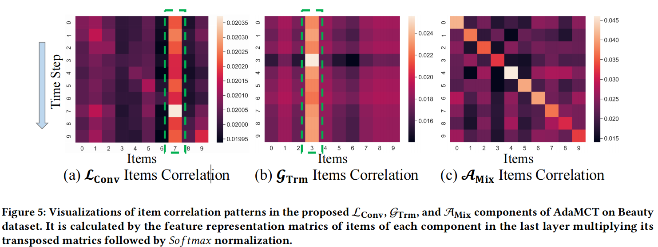
Chongqing University ^{ATAI}
_{of Technology} Advanced Technique of
Artificial Intelligence
Chongqing University of Technology
Experiments

Slide 17
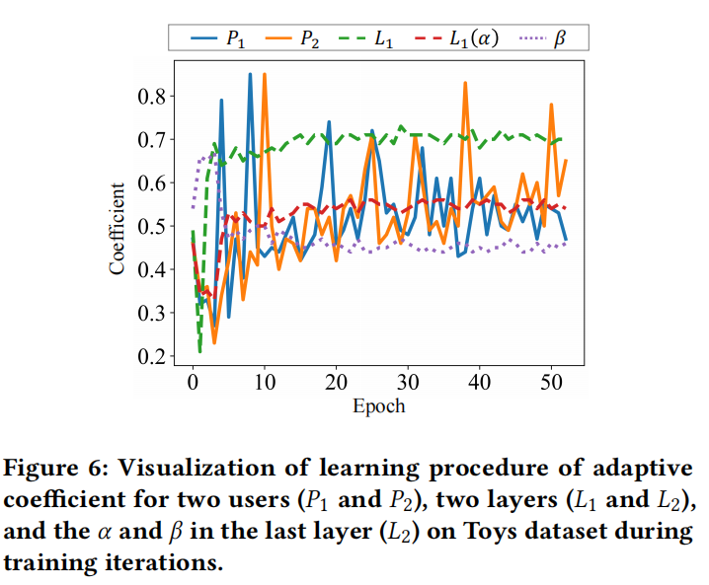
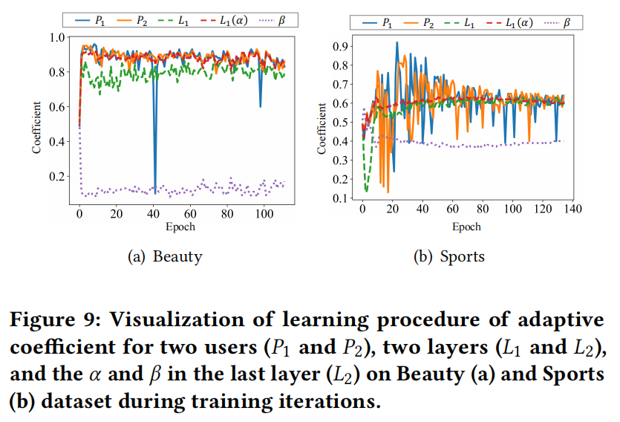
Chongqing University ^{ATAI}
_{of Technology} Advanced Technique of
Artificial Intelligence
Chongqing University of Technology
Experiments

Slide 18


Chongqing University ^{ATAI}
_{of Technology} Advanced Technique of
Artificial Intelligence
Chongqing University of Technology
Thanks

Slide 19
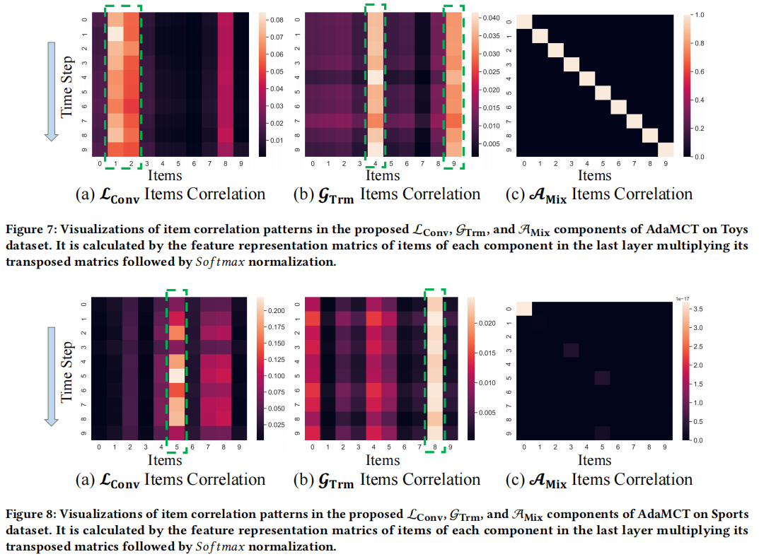
Chongqing University ^{ATAI}
_{of Technology} Advanced Technique of
Artificial Intelligence
Chongqing University of Technology
Experiments

Slide 20
Chongqing University ^{ATAI}
_{of Technology} Advanced Technique of
Artificial Intelligence
Chongqing University of Technology
Thanks

